Slide 1


Network tools
1
Network tools

Slide 2
Basic command line tools
2
Network tools

Slide 3
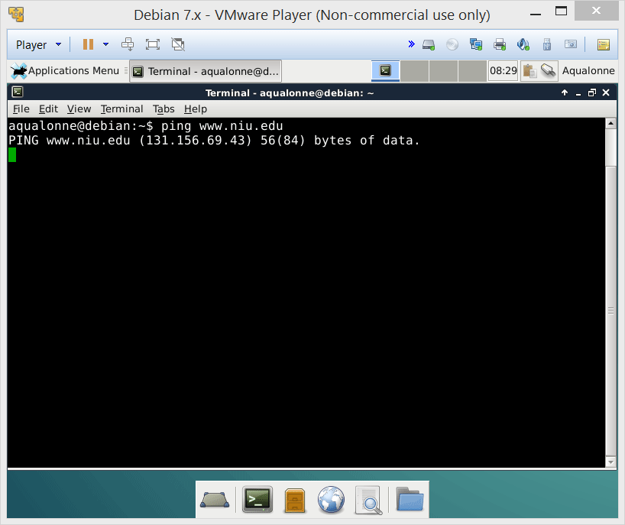
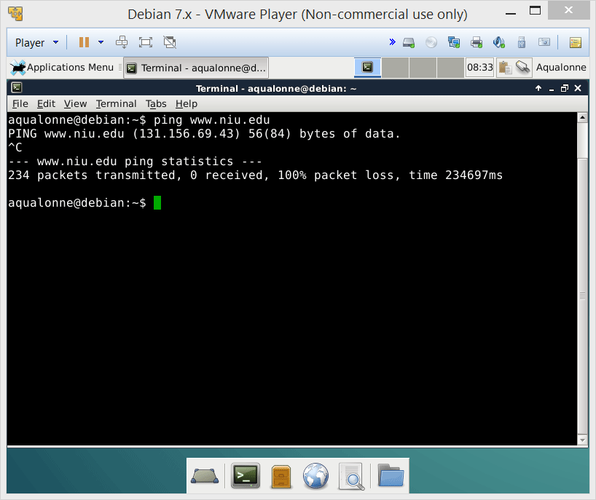
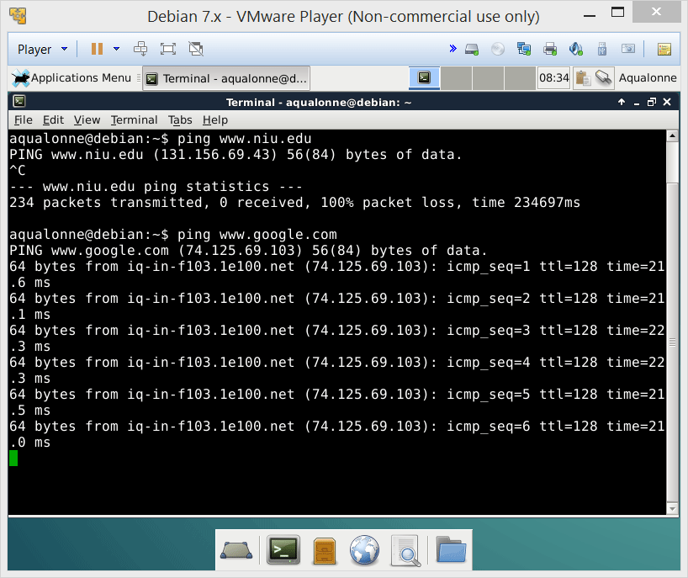
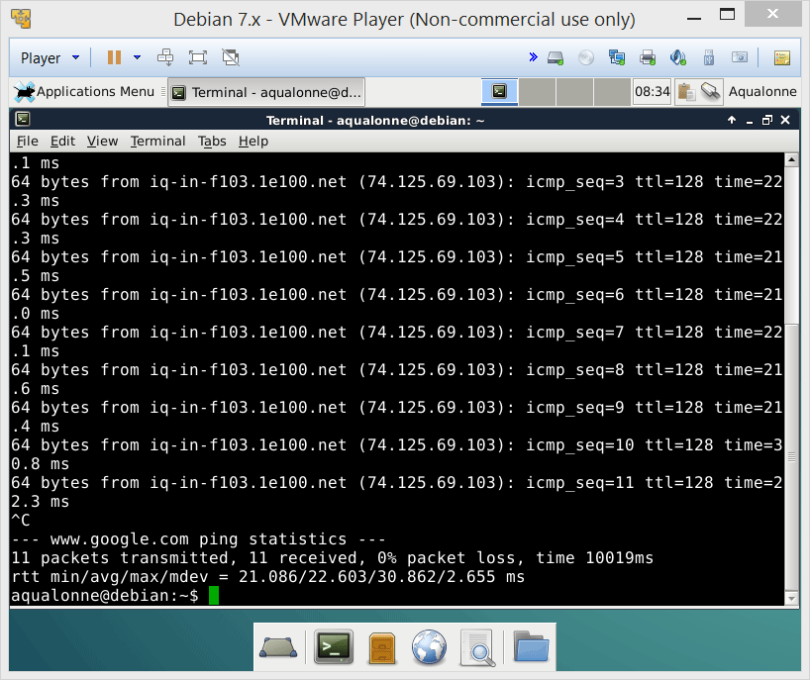
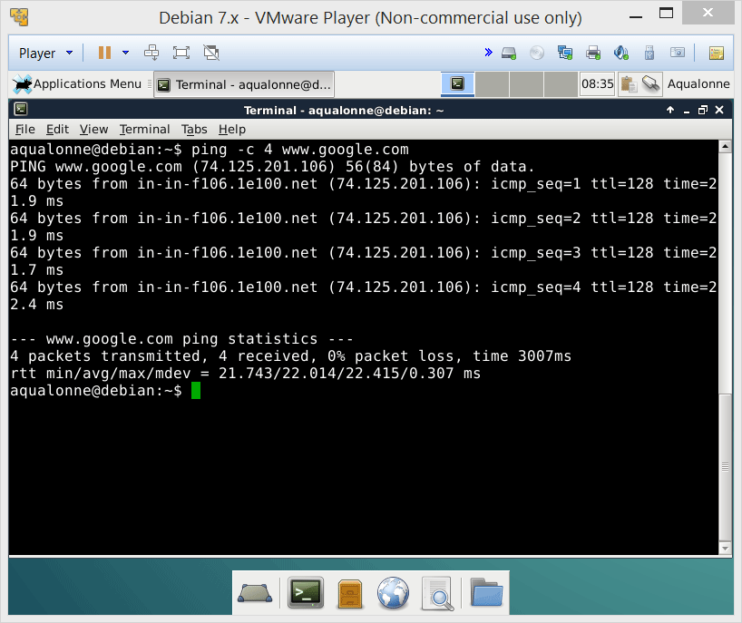
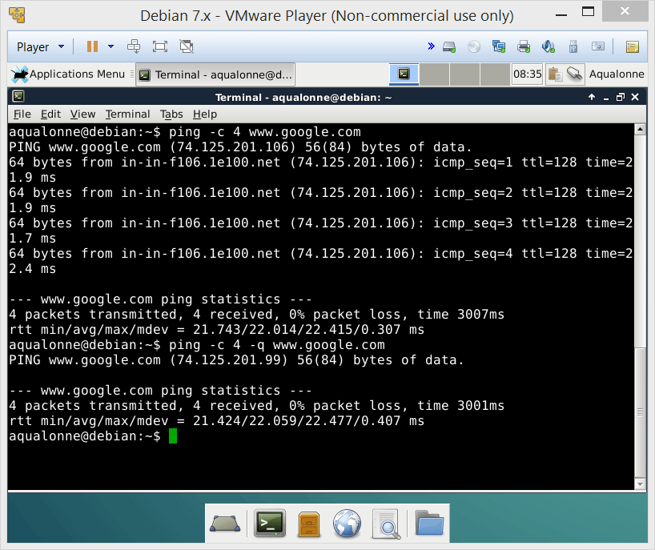
Basic command line tools
ping takes a domain name or IP, ‘pokes at it’ ad tells you how long it took to answer
If you got blacklisted from that domain, it’ll ignore you...
Useful options:
-c numberOfPokes
-q
Just show the overall stats, not each poke
3
Network tools

Slide 4

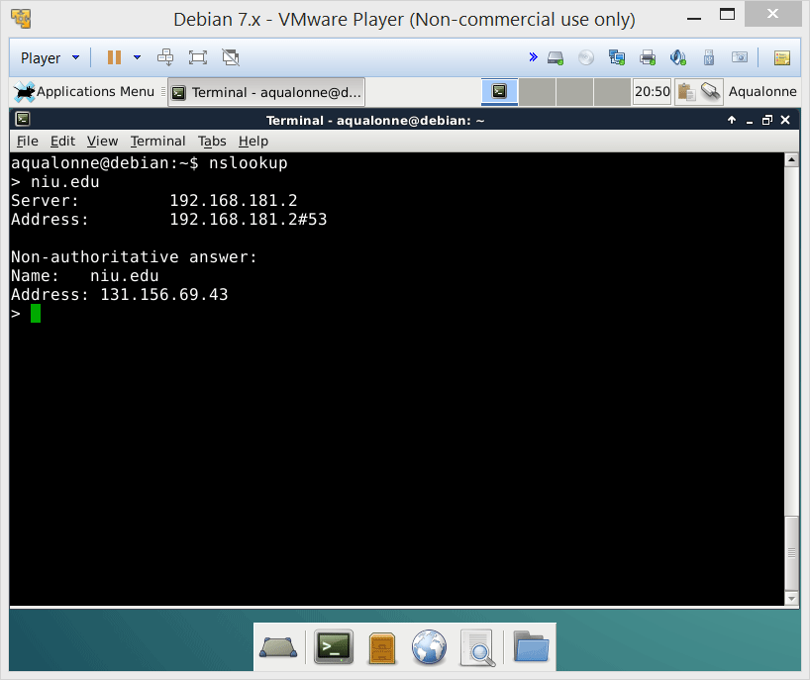
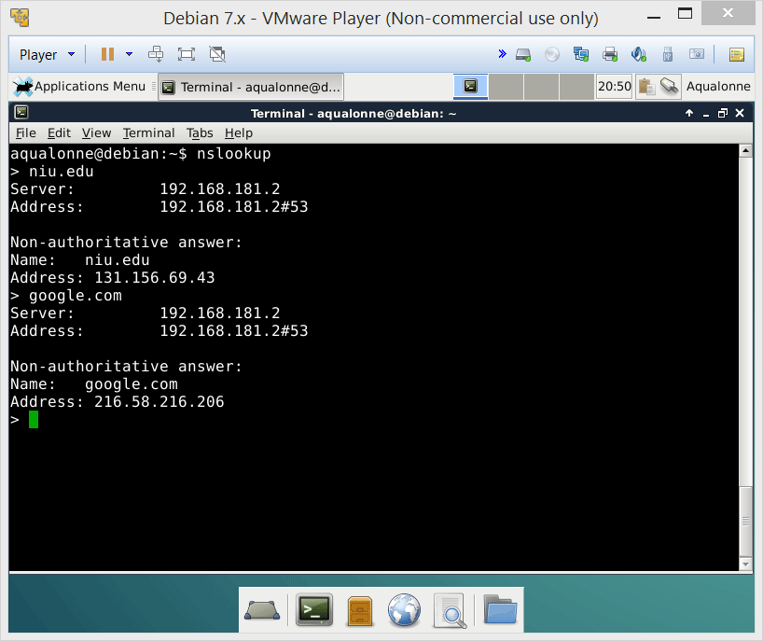
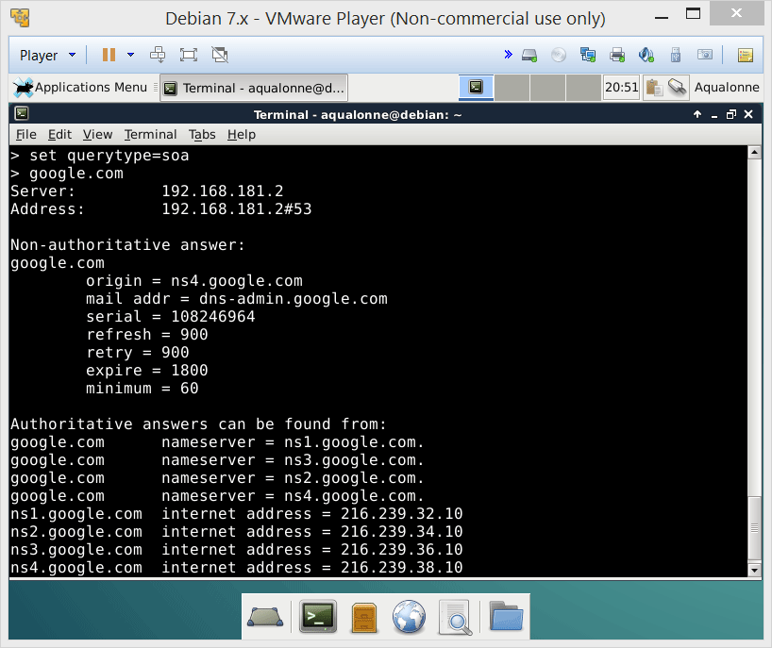
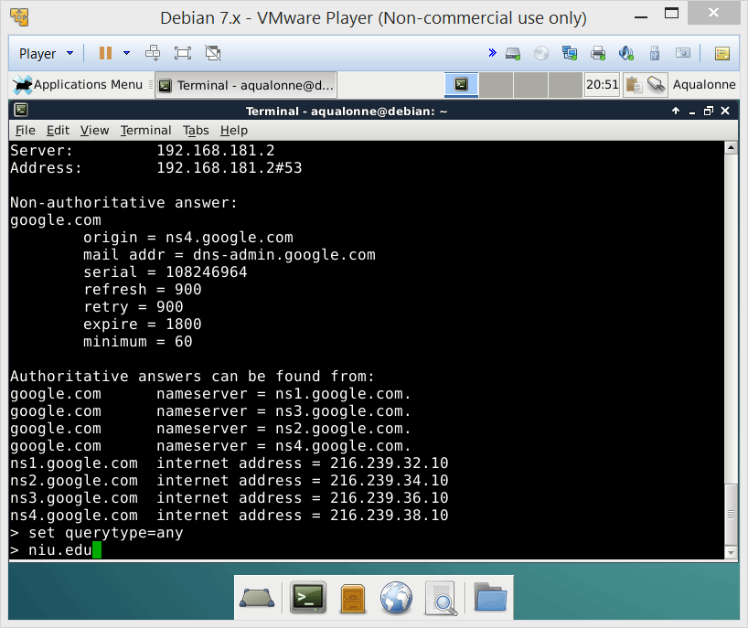
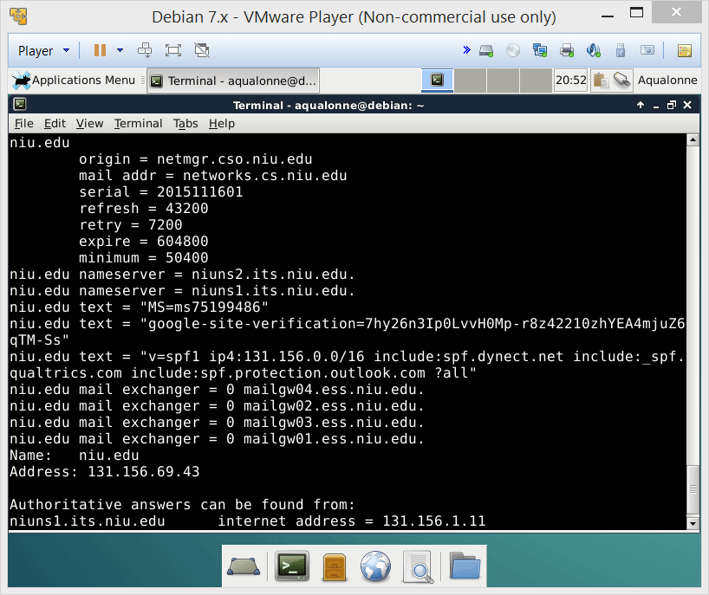
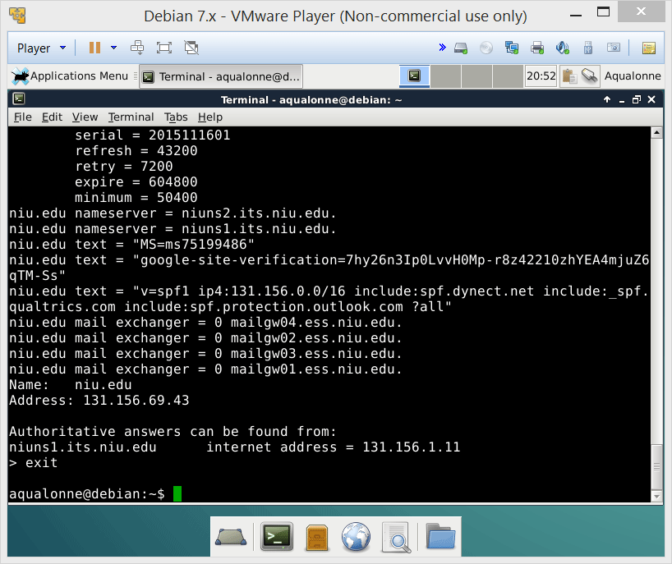
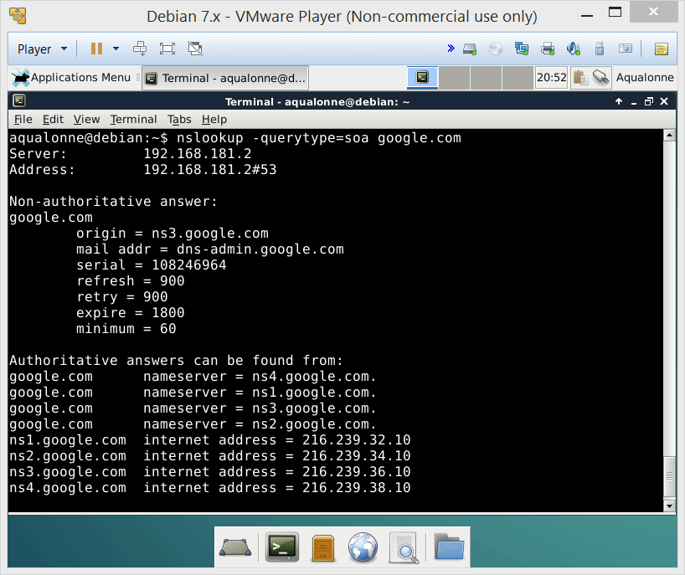
Basic command line tools
nslookup does a DNS resolution, i.e. it gives you the IP for a domain name
There are multiple ‘sources of authority’. You can do
-query=soa -query=ns
to require official answers
There is an interactive mode if you want to do multiple lookups, or just command line
4
Network tools

Slide 5
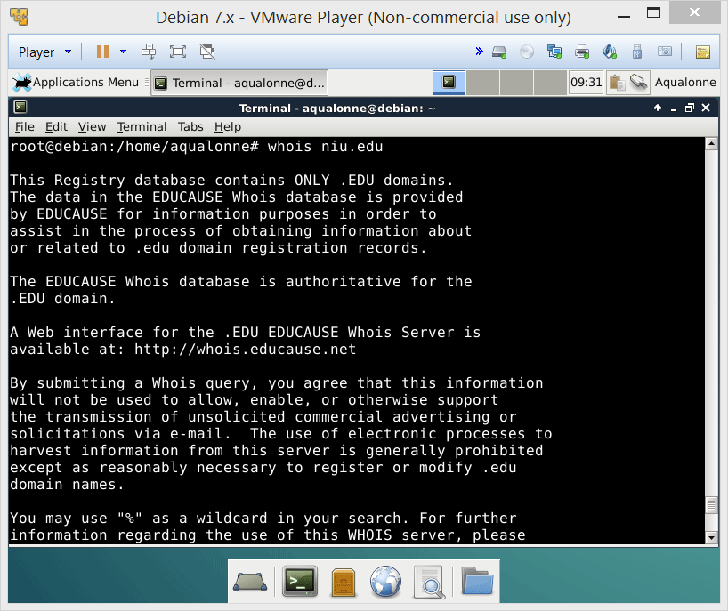
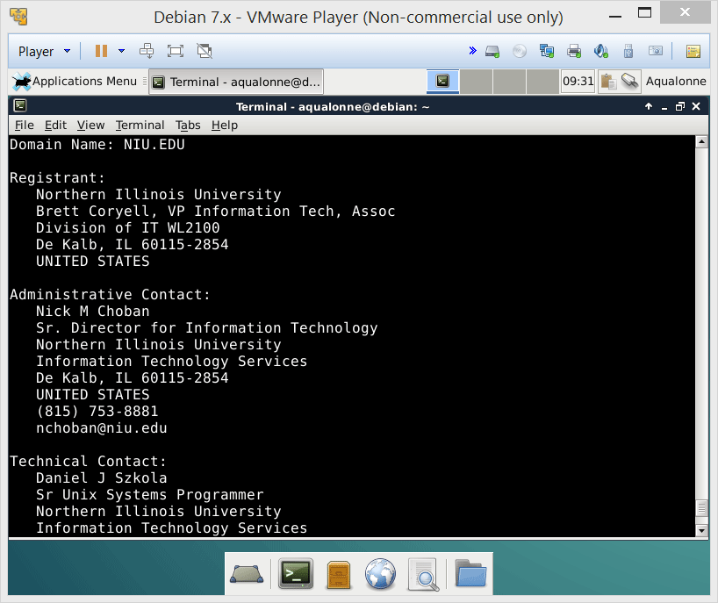
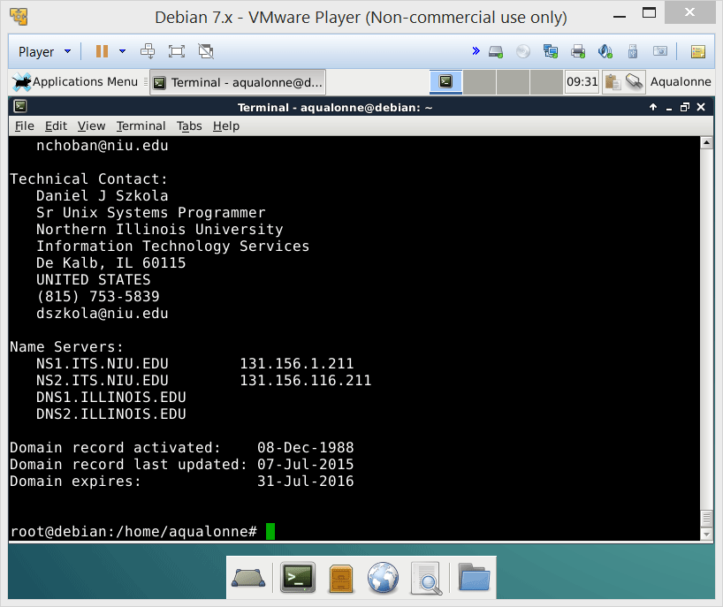
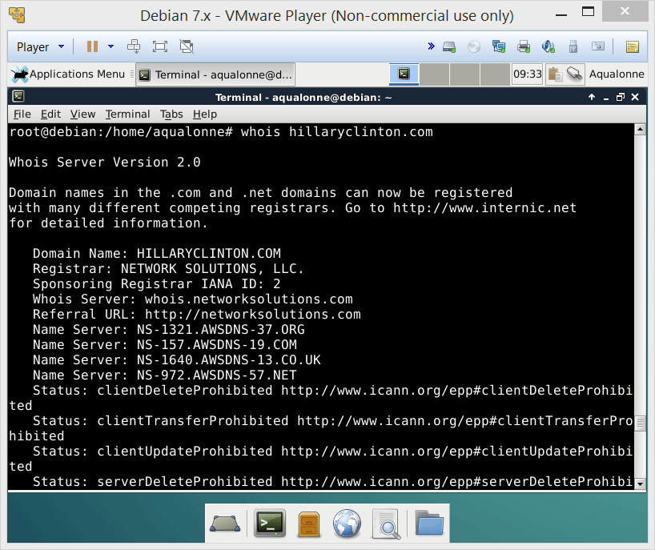

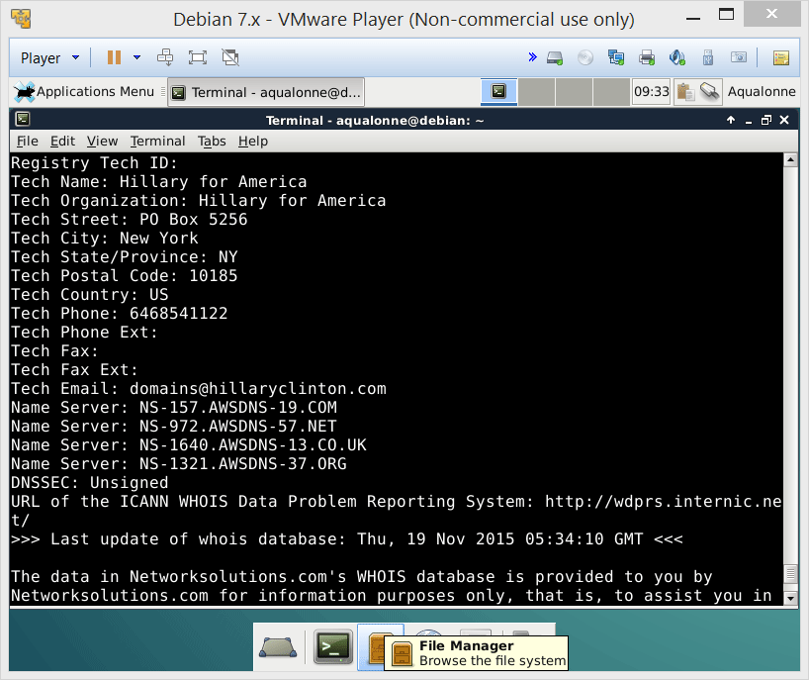
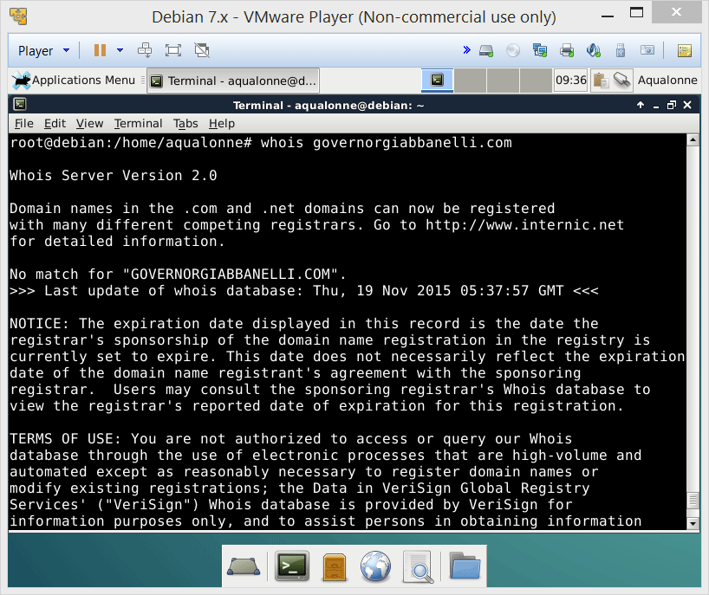
Basic command line tools
whois tells you who is behind a domain name
If you wanted to know whether a domain name was available, what line could you write?
5
Network tools

Slide 6
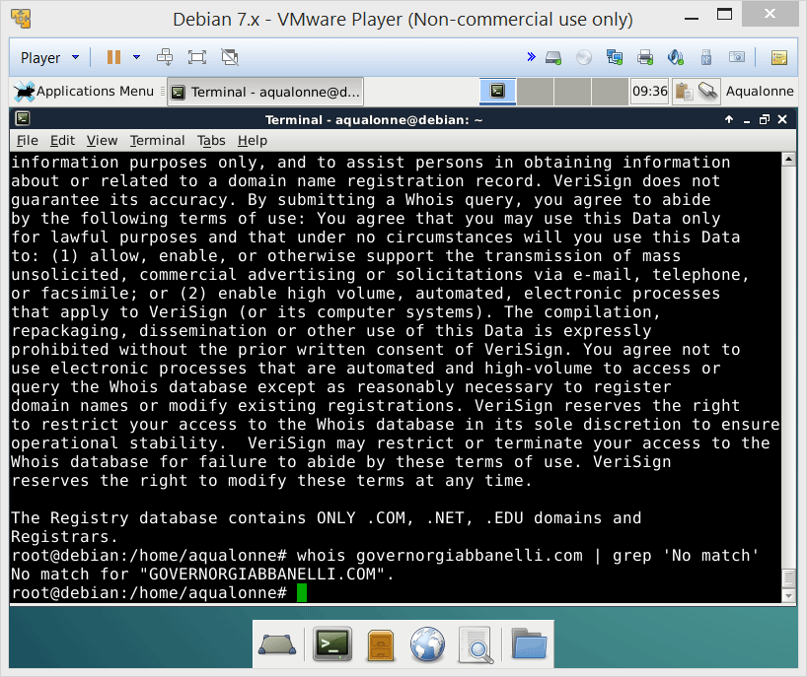
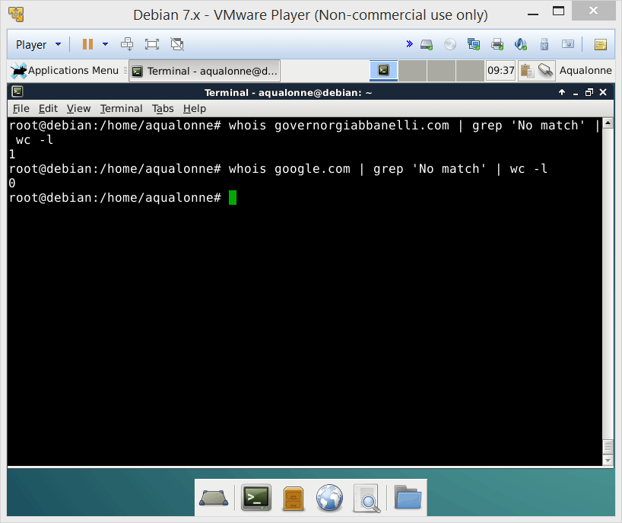
Basic command line tools
whois tells you who is behind a domain name
If you wanted to know whether a domain name was available, what line could you write?
You can do a grep to extract the network info you want, see whether there is any using wc -l, or further process it
6
Network tools

Slide 7
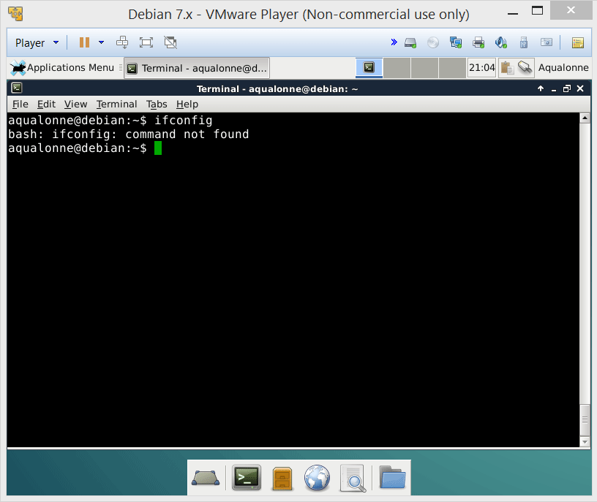
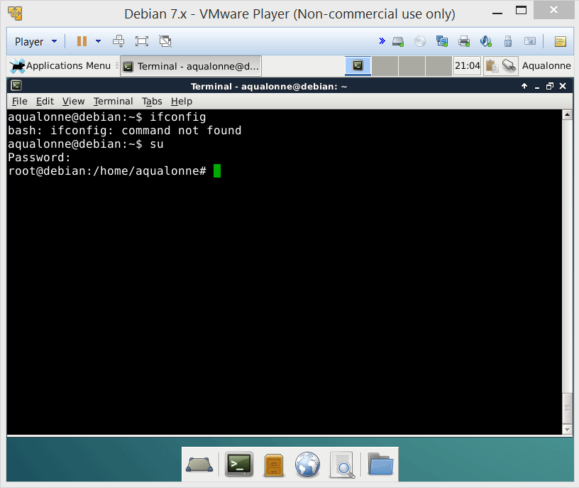
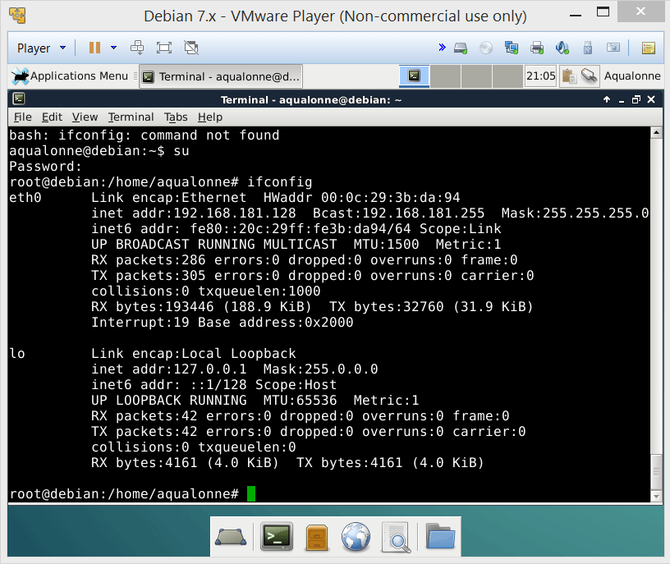
Basic command line tools
If you are root, ifconfig tells you about network interfaces
Note that some IP have a special meaning:
• 127.X.X.X is yourself
• 192.168.X.X local communications in private network (=NO internet)
• 0.0.0.0 local broadcast
7
Network tools

Slide 8
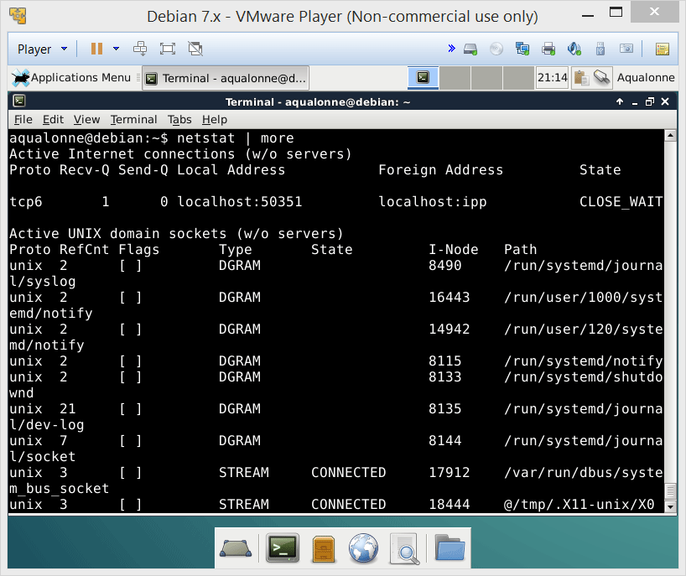
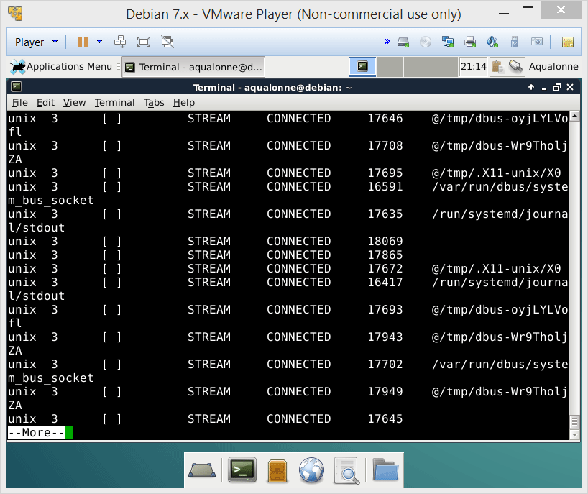
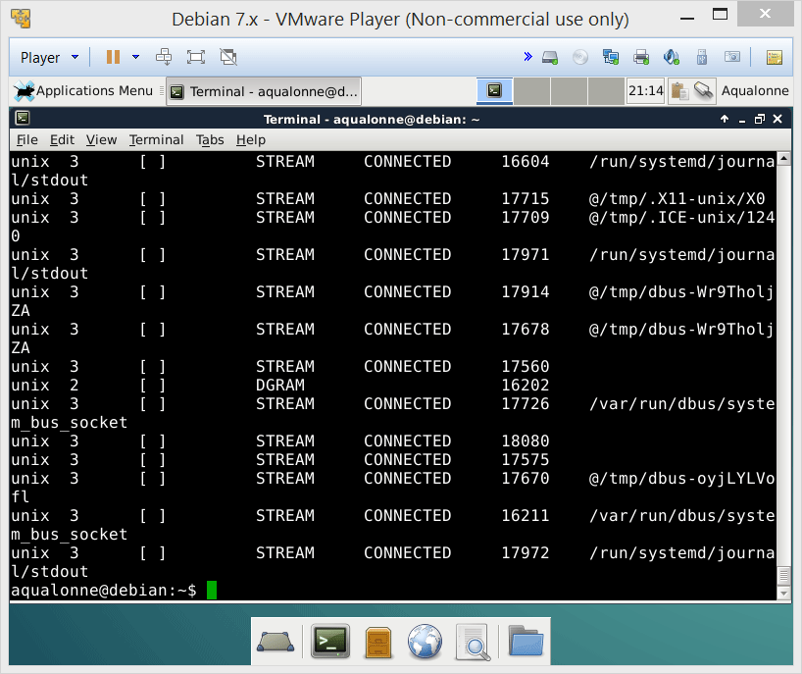
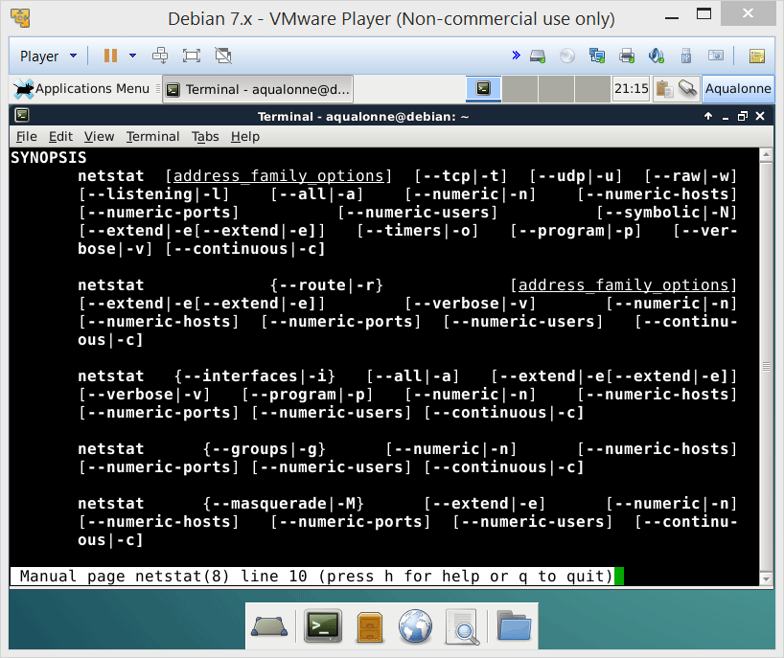

Basic command line tools
netstat is THE network monitoring tool. If you just call it, you’re going get lots...
8
Network tools

Slide 9
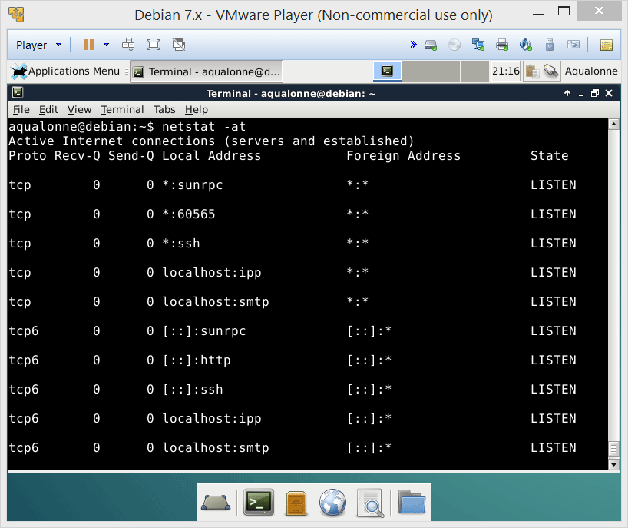
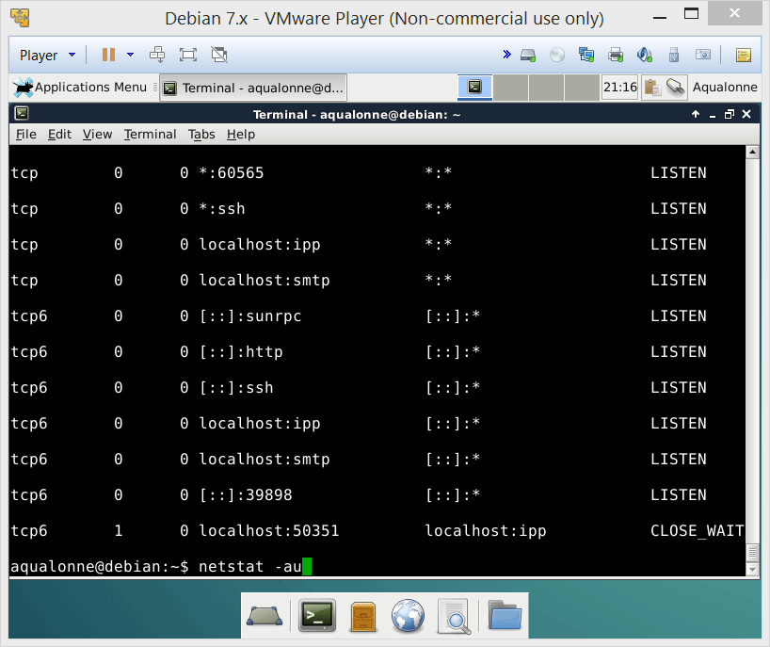
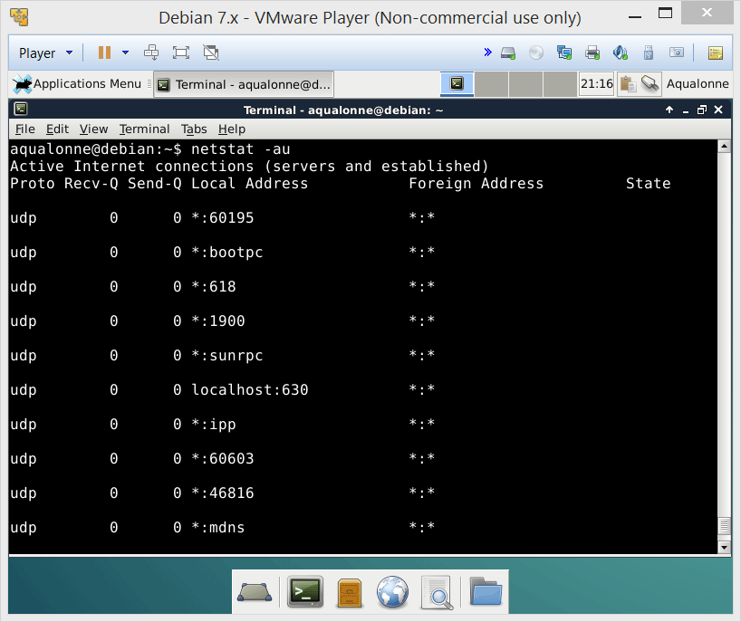
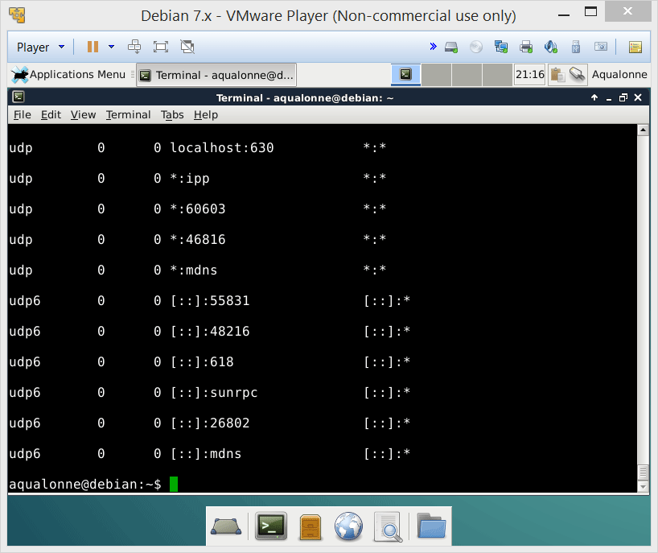

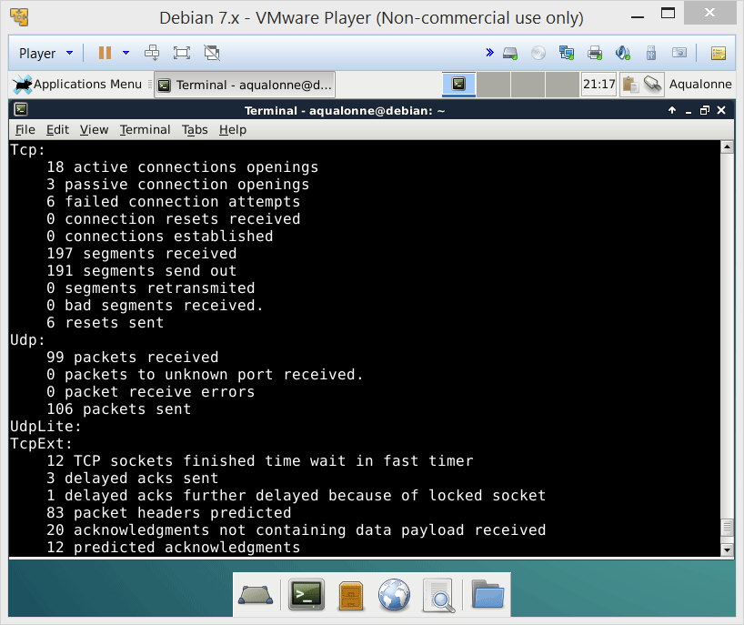
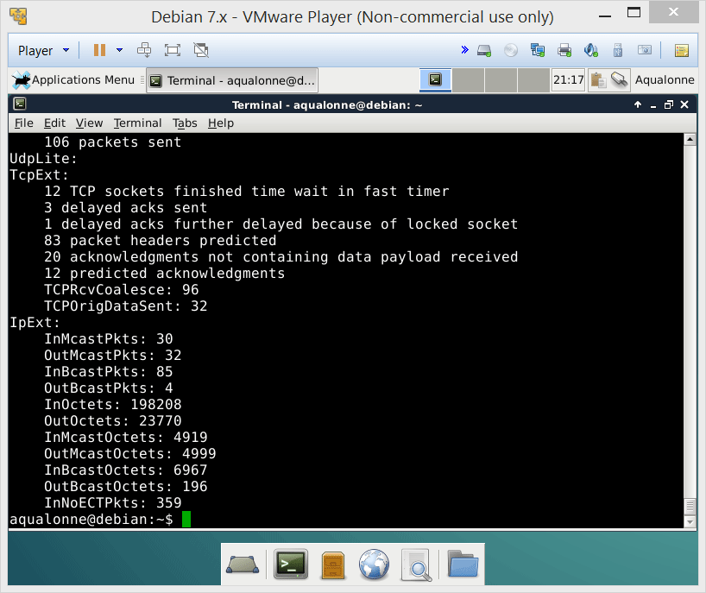
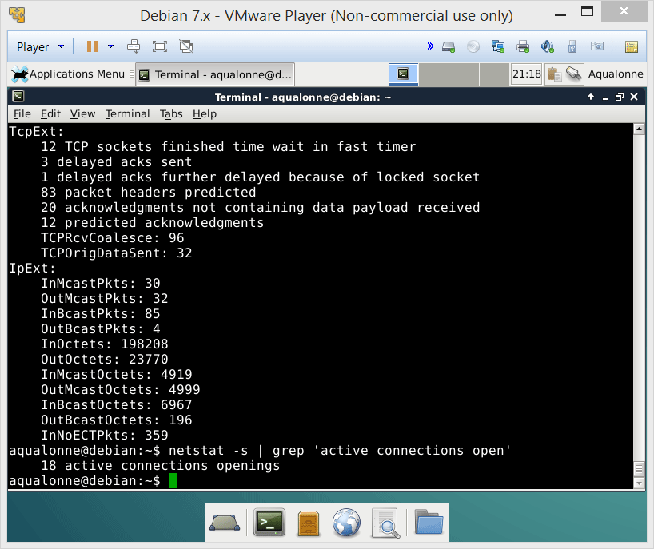
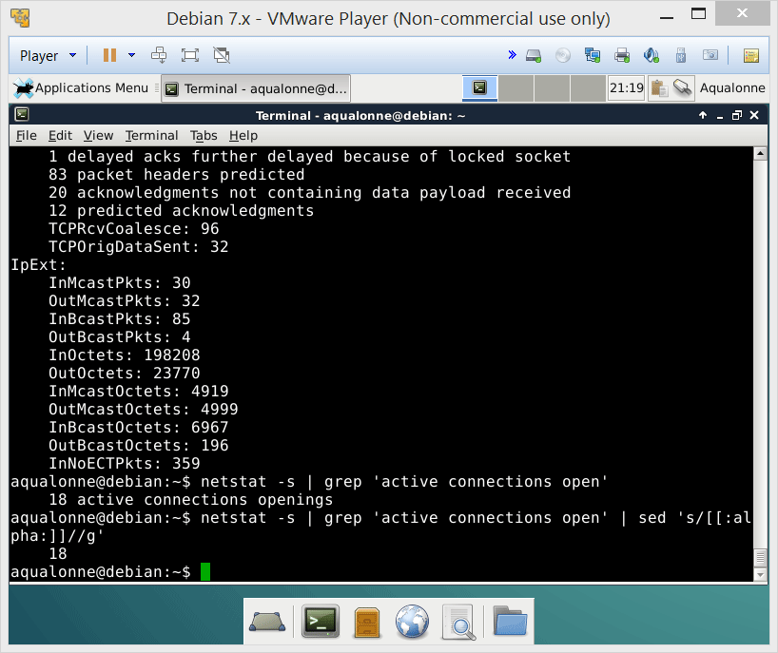
Basic command line tools
-at to look at TCP
-au to look at UDP
-s for statistics
Use grep to extract what you care about from all that junk
9
Network tools

Slide 10

Basic command line tools
To go further on network commands, check out these ones:
nmap
dig
arp
10
Network tools

Slide 11
Security tools
11
Network tools

Slide 12

Security tools: overview
Kali is a distribution of Linux that is centred on security testing and investigating computer crime
12
Network tools

Slide 13
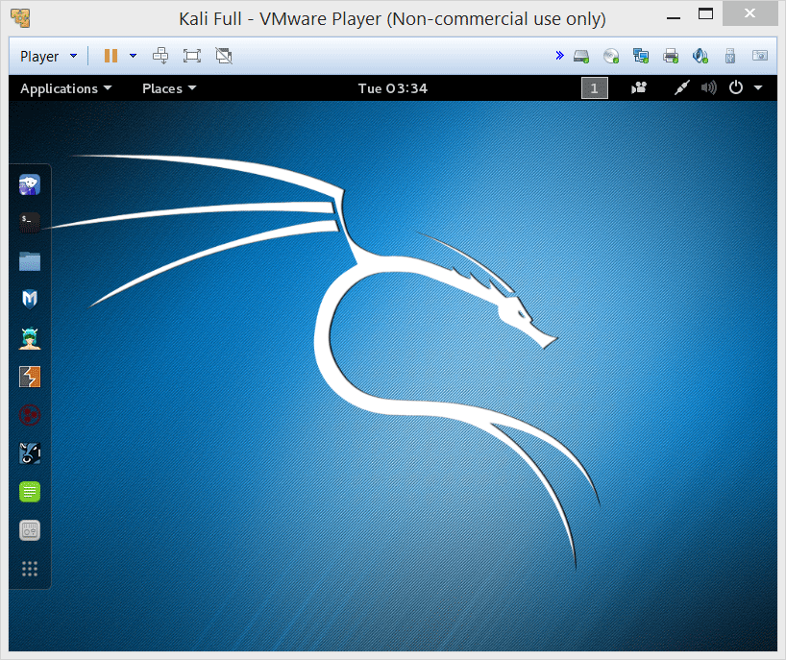
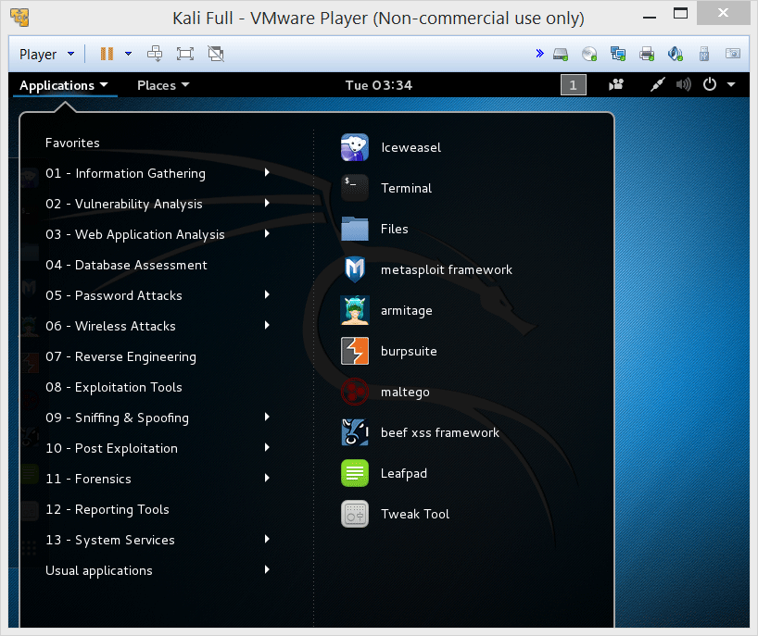
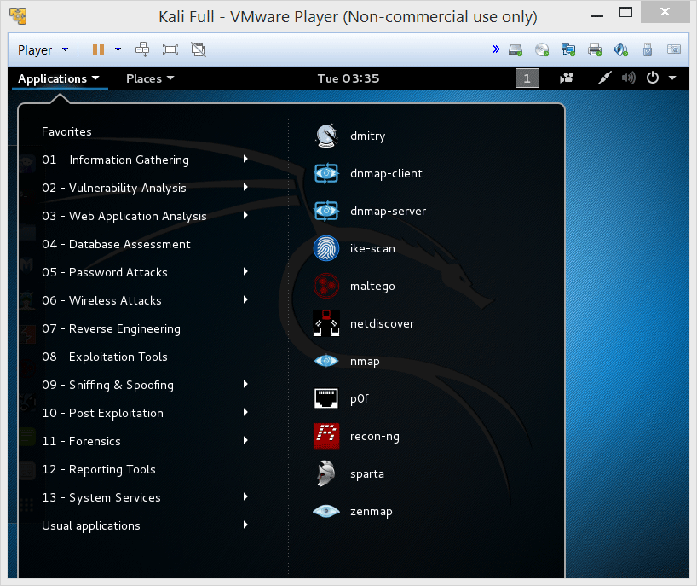
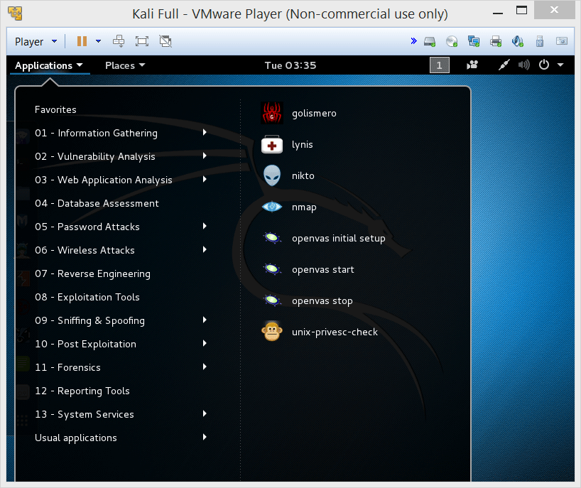
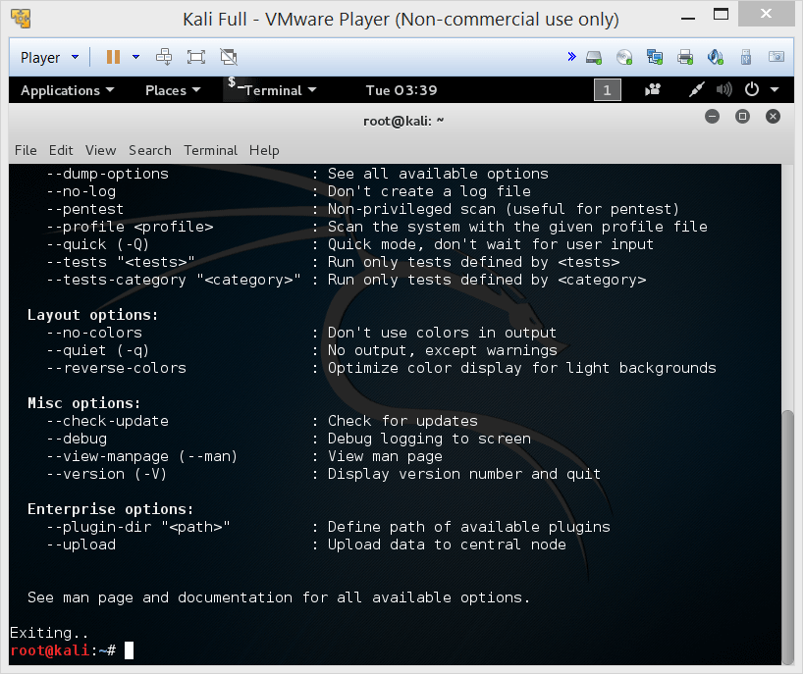
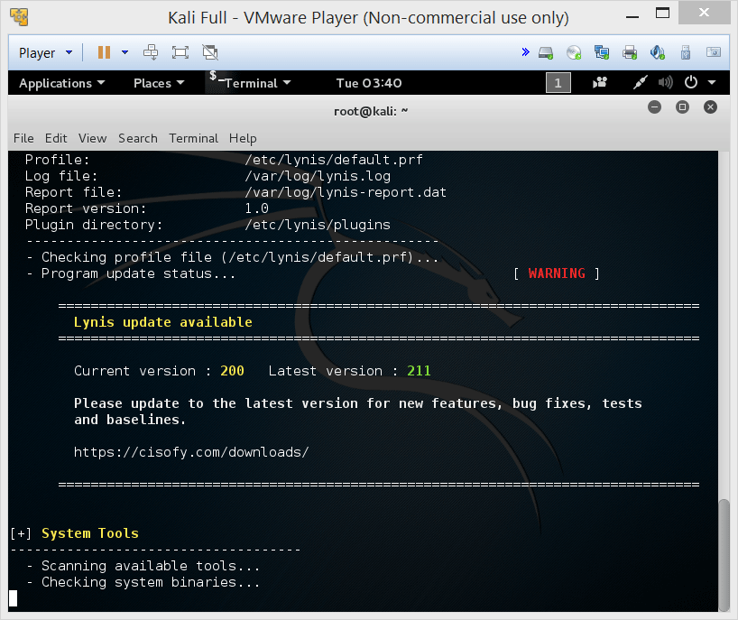
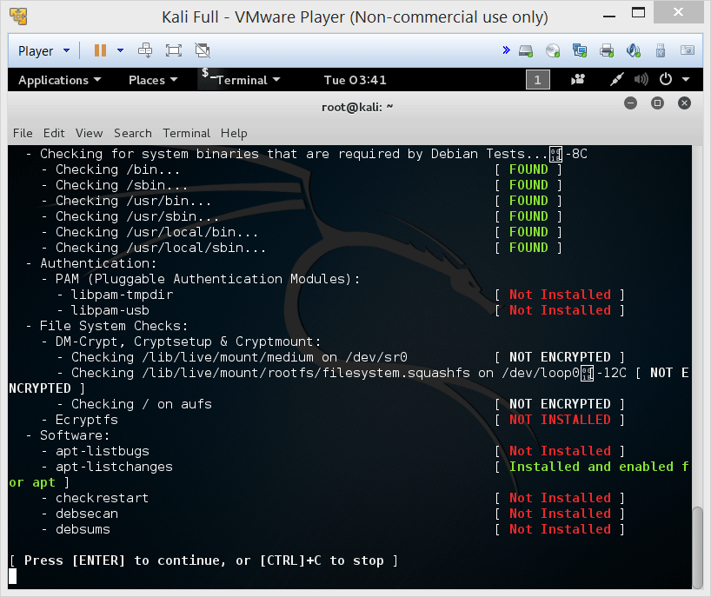
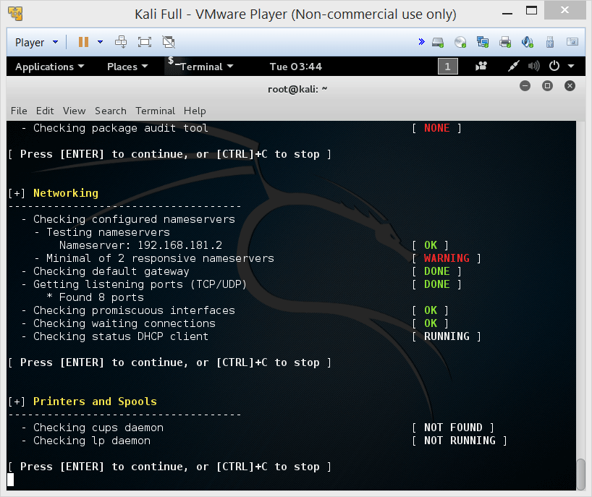
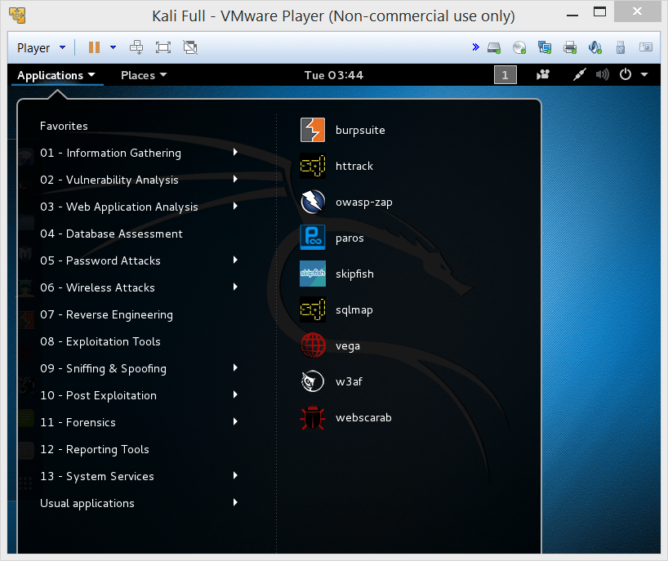
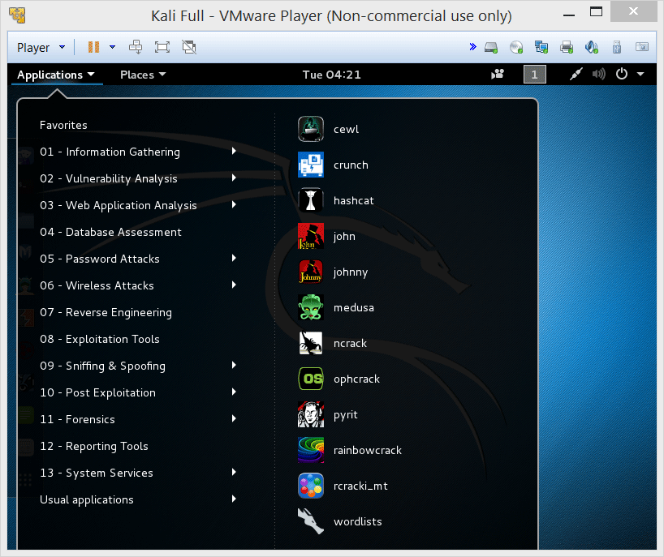
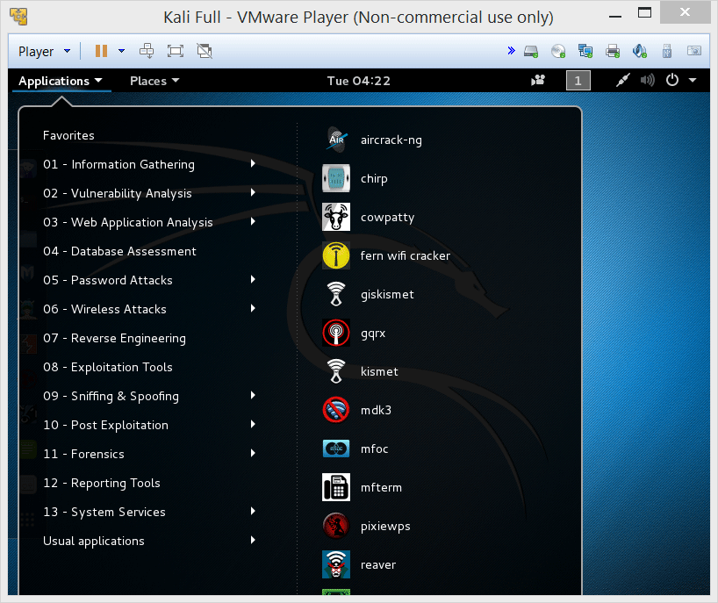
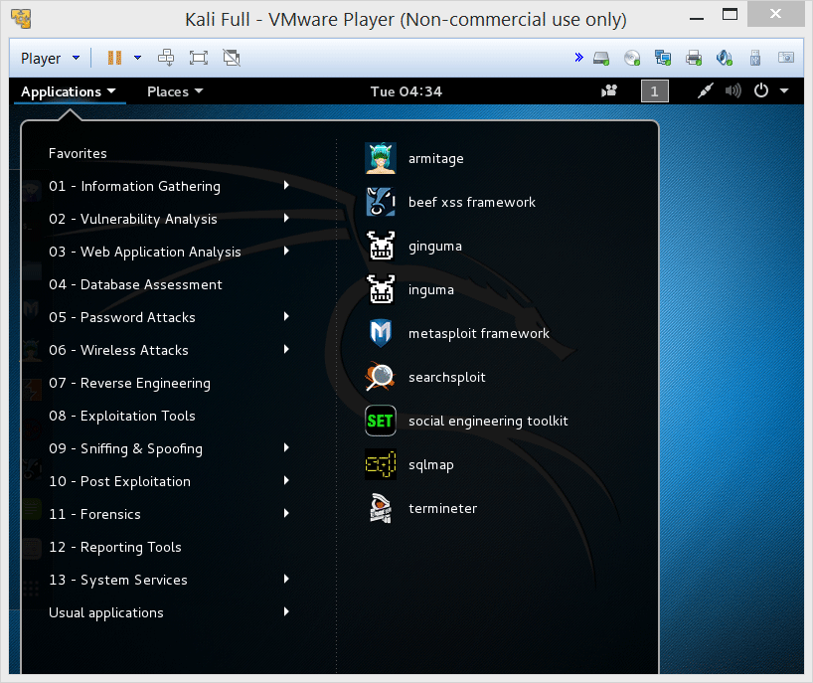
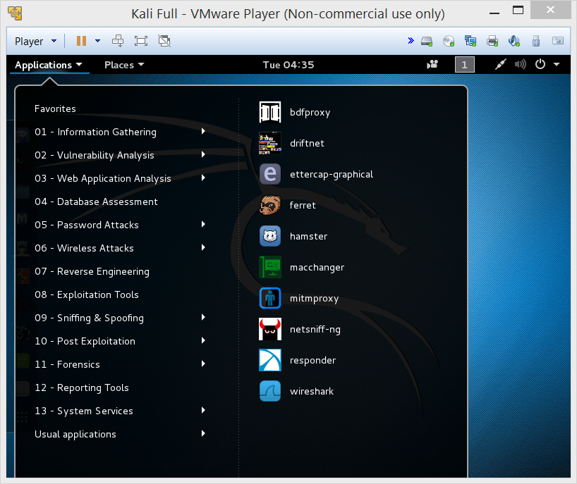
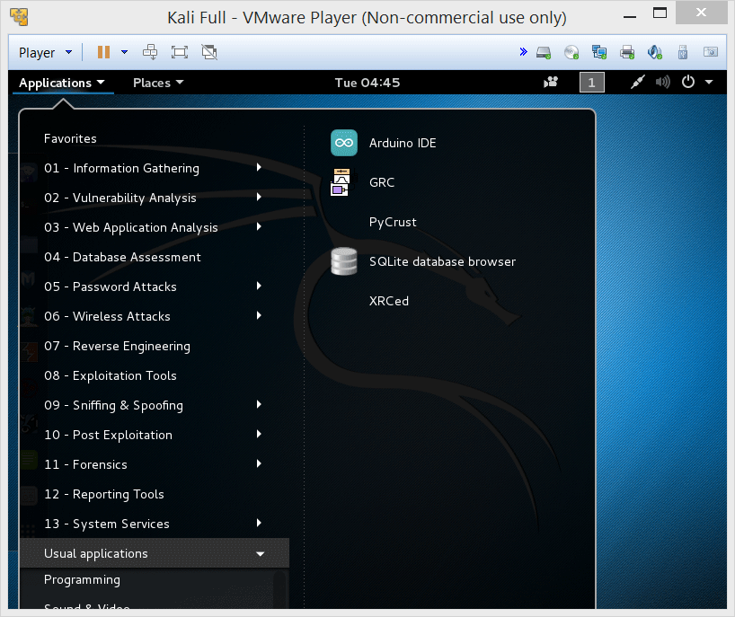
Security tools: overview
Kali’s applications are organized by security purpose and (kind of) step.
Note if you need the admin password: it’s toor
In addition to security apps, it comes with ‘normal linux’ stuff such as a terminal, some programming environment...
13
Network tools

Slide 14



Security tools: overview
What typical tools are in the box?
Sniffer
Wireshark
Understand the data that goes over the network
John the Ripper
Cracks passwords
Subterfuge
Network attack
Penetrates wifi
14
Network tools

Slide 15

Security tools: Sniffers
A packet sniffer is also called network analyzer, packet analyzer, protocol analyzer...
It intercepts and logs the traffic going over the network, then decodes it using the corresponding RFC
15
Network tools

Slide 16
Security tools: Sniffers
Why would you want to sniff on the network?
analyze network problems (e.g., user experiences long delay in sending emails)
detect intrusion attempts
monitor network usage
spy on other users to collect data such as login or cookies
reverse engineer proprietary protocols
verify internal control mechanisms (e.g., Firewall)
16
Network tools

Slide 17

WireShark is a very widely used one
17
Network tools

Slide 18




We are going to use WireShark
18
Network tools

Slide 19


















19
Network tools

Slide 20
Security tools: Sniffers
If the connection isn’t encrypted, then we can capture passwords...
20
Network tools

Slide 21














21

Slide 22







Security tools: Sniffers
But generally it is encrypted. Is there a weakness in the protocol or can we find the password and then decode the communications?
Handshaking
22
Network tools

Slide 23
Security tools: overview
What typical tools do you use?
Wireshark
Understand the data that goes over the network
John the Ripper
Cracks passwords
Subterfuge
Network attack
Penetrates wifi
23
Network tools

Slide 24





Security tools: network attack
Tools such as Subterfuge or Ettercap are built to perform specific attacks, can harvest passwords/credentials, etc.
24
Network tools

Slide 25









Security tools: network attack
Typical attacks include DoS or a distributed DoS (smurf attack), man-in-the-middle...
In an MITM, two nodes think they are directly (and privately) speaking but there is an intermediate that listens and can falsify data.
Tools such as Ettercap can perform MITM by altering routing on the local network (e.g. by ARP poison routing)
25
Network tools

Slide 26
Not-so-basic networking
26
Network tools

Slide 27







Not-so-basic networking
/etc/services contains a list of mapping of services to ports
No need for a command to query that list, just do a grep.
You could also write a script getNextFreePort.sh to know, starting from a port, what’s the first one that is not assigned to anything.
27
Network tools

Slide 28








Not-so-basic networking
nc lets you operate a simple client/server
With nc -l you listen for incoming connections, and with nc ...ip... ...port... you connect
How would you use this to transfer files?
28
Network tools

Slide 29













Not-so-basic networking
On the server side you can redirect everything you get into a file
On the client side you can pipe into nc, so for example you can open and send a whole file
29
Network tools

Slide 30




Not-so-basic networking
There are ways to get a specific program to handle the client. Here, we give the shell to the client.
From a security viewpoint, what do you think about having a port open for anybody to use our shell?
Totally insane. If you want to get a shell, authenticate by doing an ssh ☺
30
Network tools

